Slide 1

WIPRO NGA Program – DWS
Capstone Project Presentation – 17th June & 18th June 2025
Project Title - Digitally Sign an MSIX Package – Create or use a certificate to sign an MSIX package
Presented by – 28953 – Kranti Jadhav
www.rpsconsulting.in

Slide 2

Introduction
This project is about how to digitally sign an MSIX package. Signing is an important step to make the package trusted and secure
Digital signing is like putting a seal or signature on your MSIX package . It shows that the package is genuine and safe to install.
MSIX Packaging Tool is used to sign the package. Signing increases security, builds trust, and is required when deploying MSIX apps through platforms like Microsoft Intune
2024 - RPS Consulting all rights reserved

Slide 3
Objectives
To Create or use a certificate to digitally sign an MSIX package
Learn how to use MSIX Packaging Tool and PowerShell.
Sign the package to make it secure and trusted
Understand how digital signing helps avoid installation warnings and builds trust during app deployment
2024 - RPS Consulting all rights reserved

Slide 4
Prerequisites
Windows 11 machine
MSIX Packaging Tool installed
Certificate file (.pfx)
PowerShell (for certificate creation)
2024 - RPS Consulting all rights reserved

Slide 5


Introduction-to-Tools
MSIX Packaging Tool
PowerShell
2024 - RPS Consulting all rights reserved

Slide 6
Flow chart
Create a .pfx certificate
Create or use existing MSIX package
Sign package using MSIX Tool
Verify digital signature
2024 - RPS Consulting all rights reserved

Slide 7
To Get Started With This Project
1. Use PowerShell to create a self-signed certificate
2. Install MSIX Packaging Tool
3. Create a package or use an existing package
4. Sign it after packaging
2024 - RPS Consulting all rights reserved

Slide 8
Usage Process
1. Open MSIX Packaging Tool
2. Click on the Package editor
3. A Package editor window will get open In that select Sign with a certificate
4.Browse the certificate that is created using PowerShell command
4. Type the password and click on Save
5. The package will get digitally signed
2024 - RPS Consulting all rights reserved

Slide 9
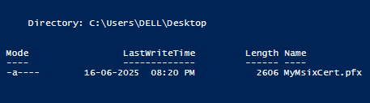
Execution Overview
1. Create a Certificate Using PowerShell use the below command to create a certificate
$cert = New-SelfSignedCertificate -Type CodeSigningCert -Subject "CN=MSIXTestCert" -CertStoreLocation "Cert:\CurrentUser\My"
Export-PfxCertificate -Cert $cert -FilePath "C:\Users\DELL\Desktop\MyMsixCert.pfx" -Password (ConvertTo-SecureString -String "Test@123" -AsPlainText -Force)
2024 - RPS Consulting all rights reserved

Slide 10
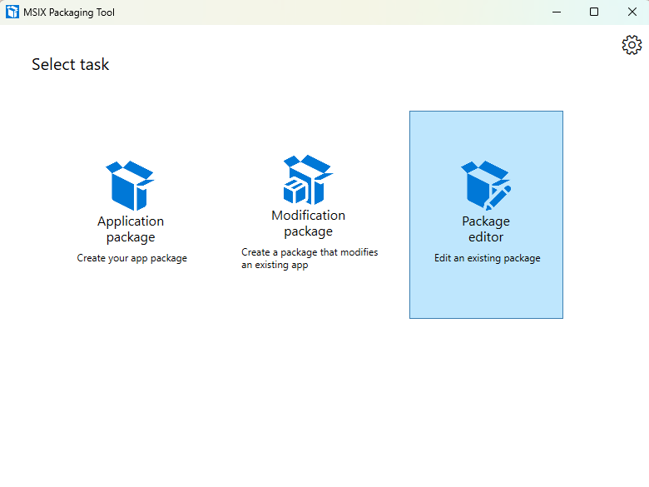
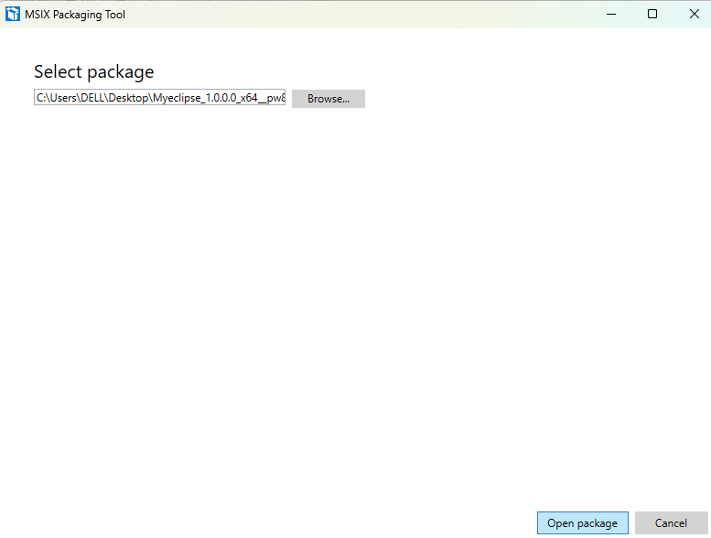
Execution Overview
2. Click on the Package editor
3. Browse Package and Click on open
2024 - RPS Consulting all rights reserved

Slide 11
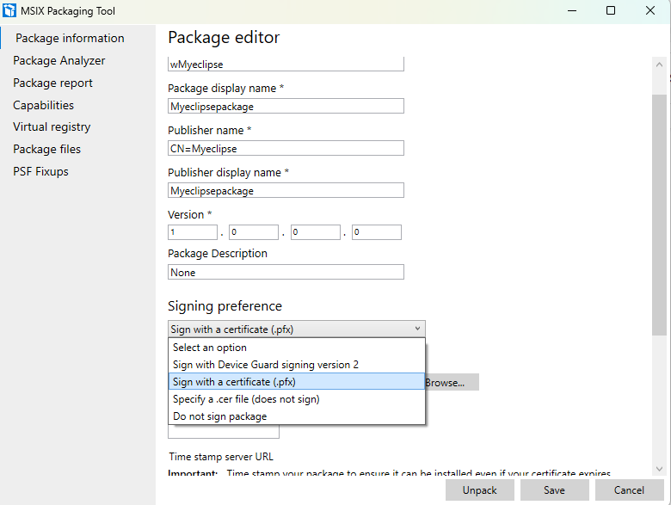
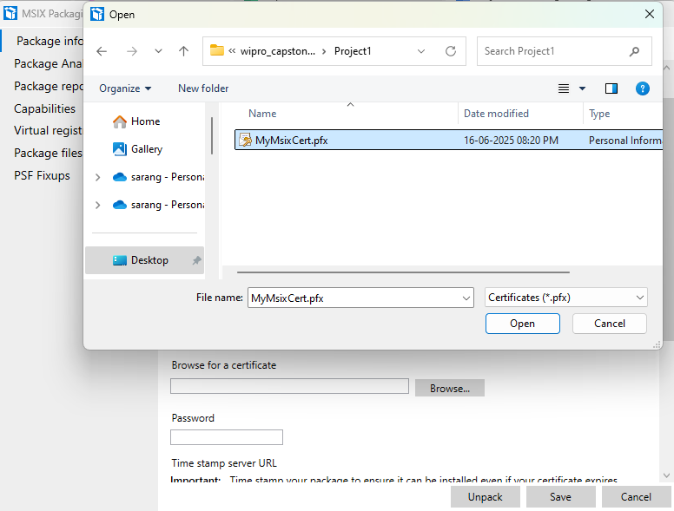
Execution Overview
4. Select the Sign with a certificate
5. Browse the certificate
2024 - RPS Consulting all rights reserved

Slide 12
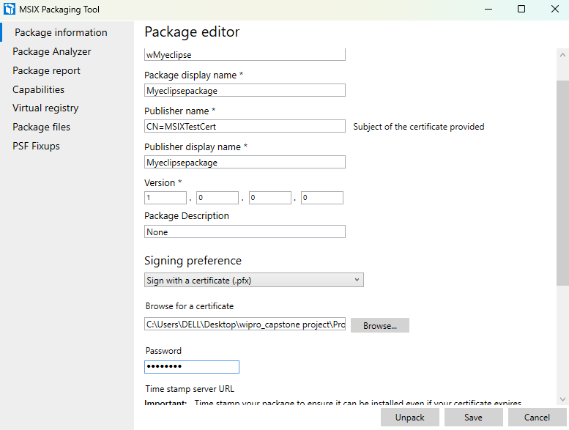
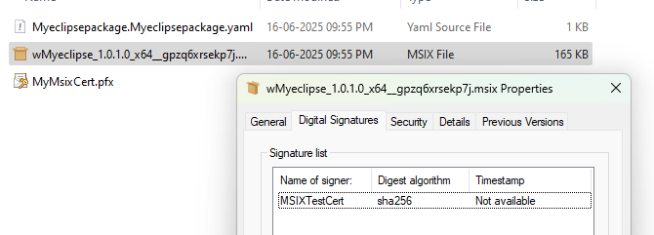
Execution Overview
6. Type the password, click on save
7. verify it by visiting the Digital signature tab
2024 - RPS Consulting all rights reserved

Slide 13
Reference
1. Advanced Installer
https://www.advancedinstaller.com/application-packaging-training/msix-packaging/ebook/digital-signing.html#:~:text=How%20to%20sign%20an%20MSIX,for%20signing%2C%20and%20other%
2. Microsoft
https://learn.microsoft.com/en-us/windows/msix/package/signing-package-overview
3. Code Signing store
https://codesigningstore.com/how-to-create-self-signed-code-signing-certificate-with-powershell
2024 - RPS Consulting all rights reserved

Slide 14
Thank You
2024 - RPS Consulting all rights reserved

